Slide 2
Finding accommodation
How to apply for accommodation
Advice
Opportunities
Affordability
What are the Key Issues ?

Slide 3
Residential Care Home
Residential School
Full package
Company of others
24 hour staff
No control over who you live with and who supports you
Low personal income
Access to education
Notes:
Everyone can have access to education either via EHCP or community resources so maybe should not be here as it would be the case across the board no matter where they are living. LF

Slide 4
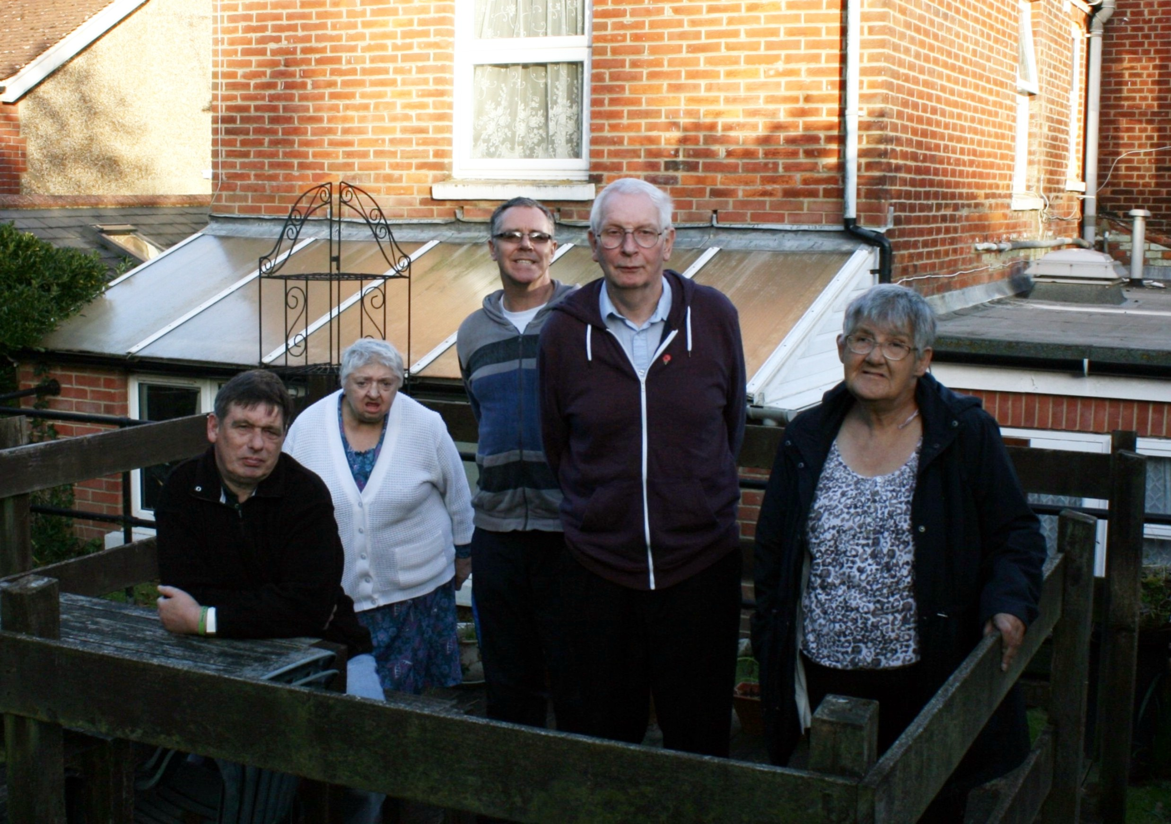
Shared Supported Housing
Company of others
Shared responsibilities - cooking, cleaning and paying the bills
Have a tenancy - rights
Access to full welfare benefits
No full control over who you live with and who

Slide 5
Shared Lives
Provides a family environment
Living in a normal house in a normal street
Independence can be limited
Living according to family rules and way of life
https://sharedlivesplus.org.uk/news-campaigns-and-jobs/about-us/
Notes:
Not sure I like the word ‘normal’ LF

Slide 6
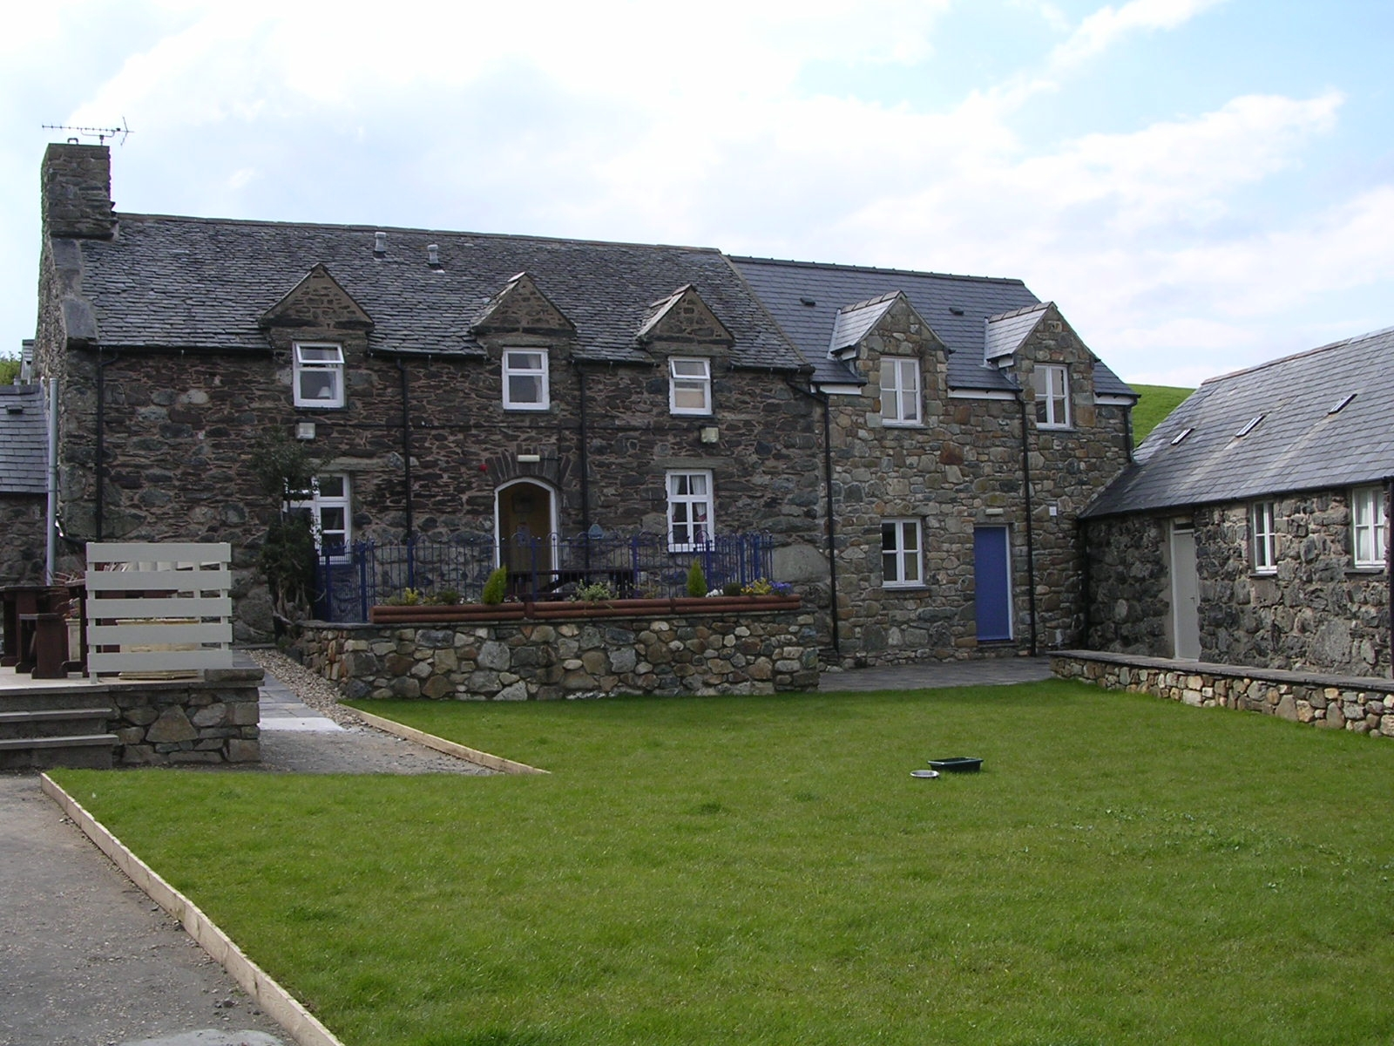
Independence + access to support
Living close to others who have a similar disability
Access to full welfare benefits
Not ‘ordinary’ housing
Cluster Flats

Slide 7
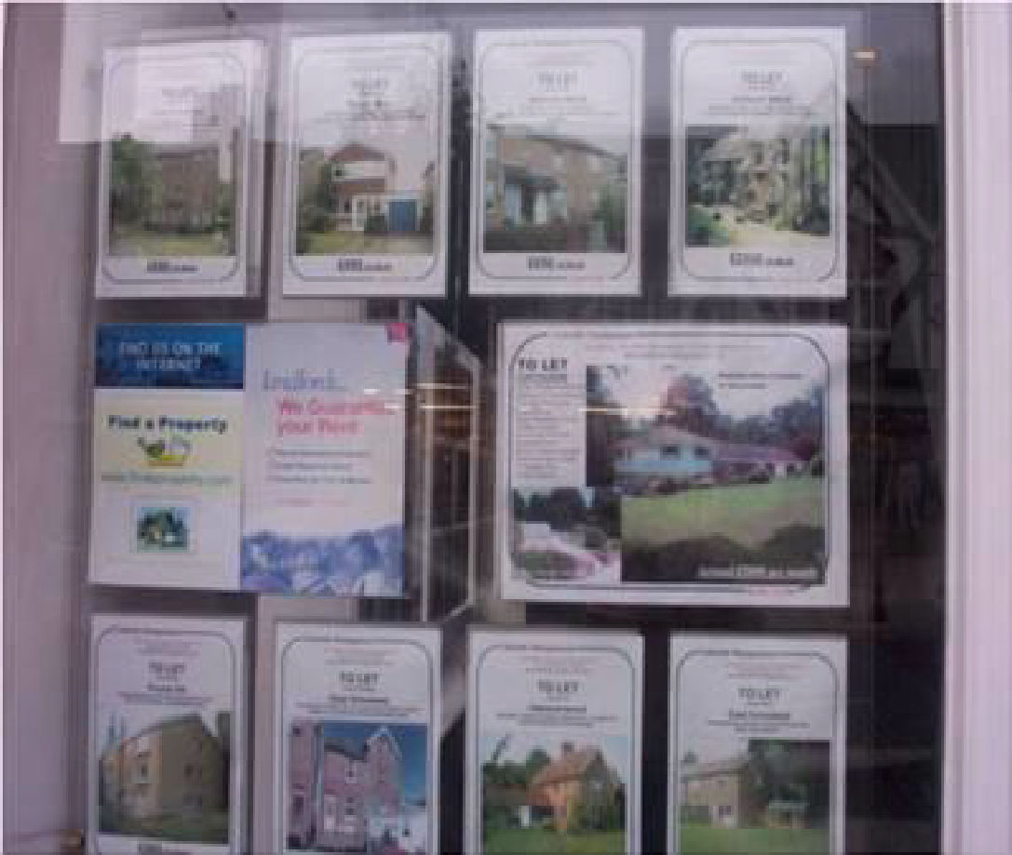
a
Ordinary Housing Options

Slide 8
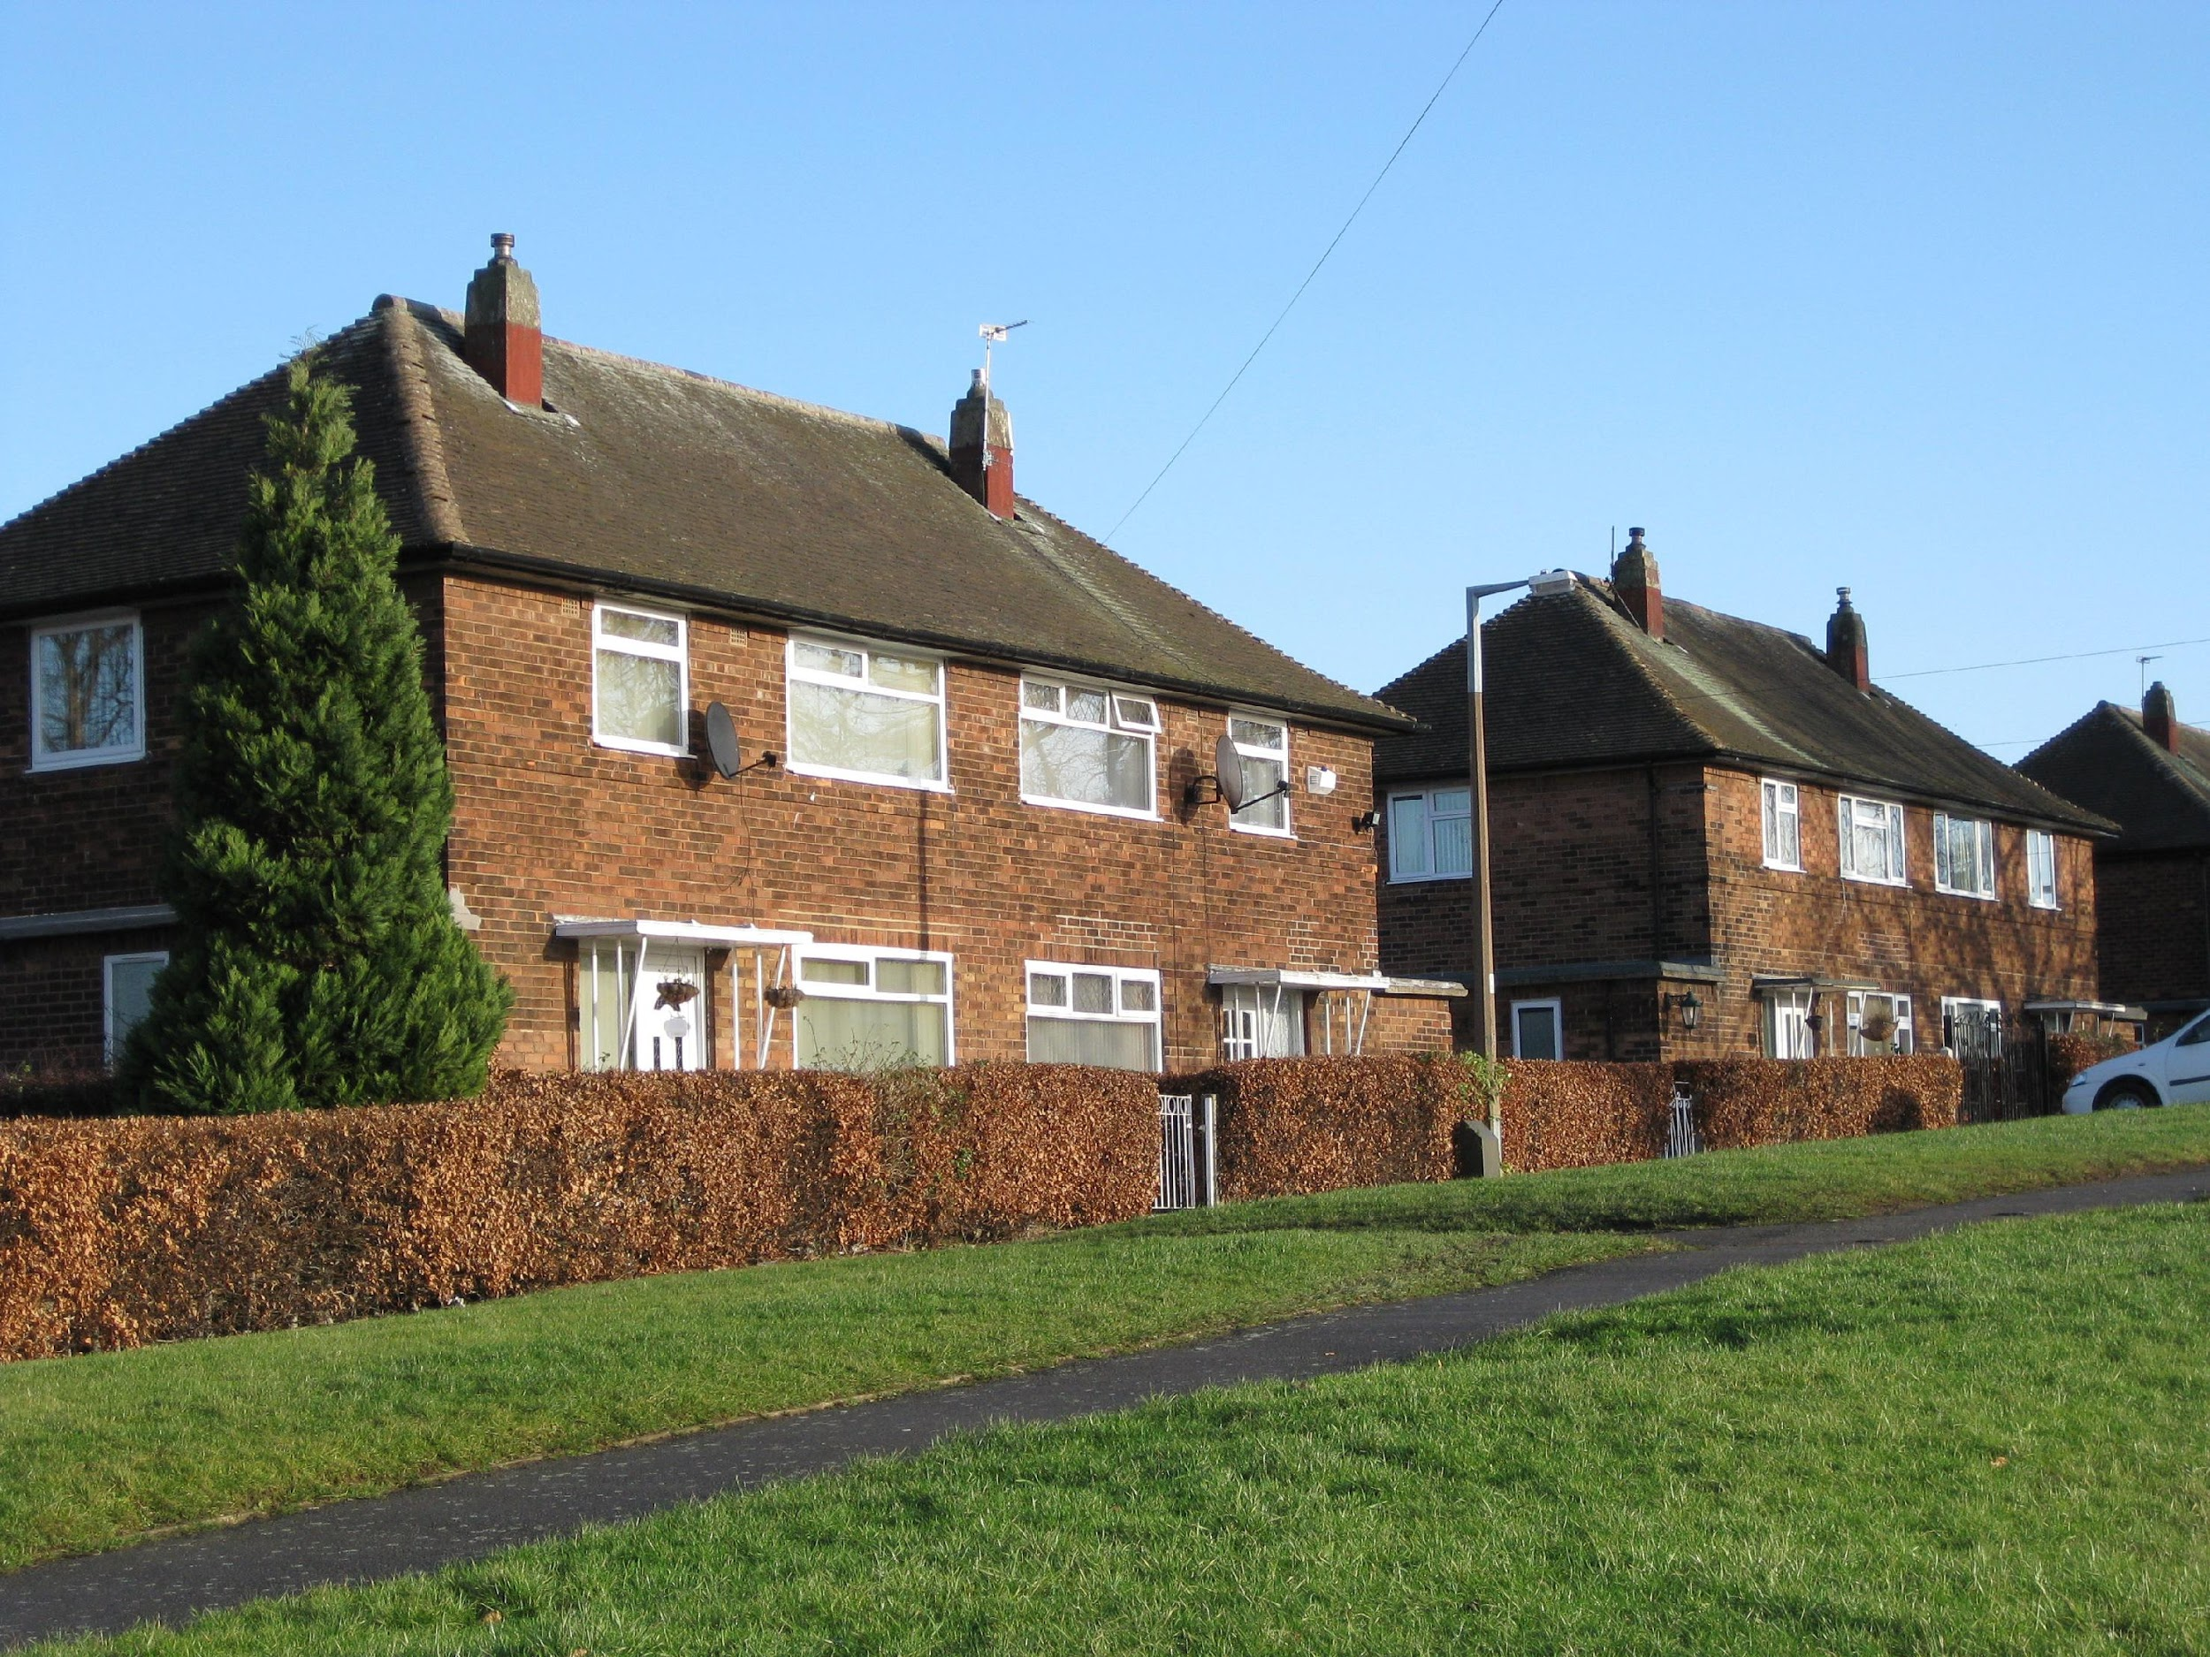
Secure way of renting own home
Affordable rents – especially if working
Choice limited
Long time to wait
Renting from Council

Slide 9
The Housing Register is a list of people who want to be re-housed by a Council
The housing register is also known as The Waiting List
People can also join the housing register if they want to be put forward to a housing association
You can apply if you’re 18 or over (some councils let you apply if you’re 16 or over)
https://www.sutton.gov.uk/info/200335/at_home/1084/finding_somewhere_to_live/2
What is the Housing Register ?

Slide 10
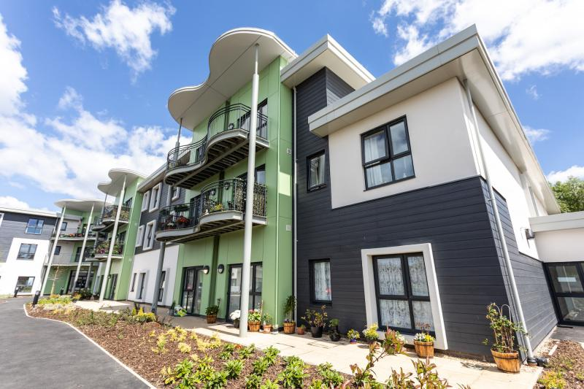
Secure way of renting own home
Affordable rent – especially if working
Long time to wait
Choice limited
Renting from Housing Association

Slide 11
Through estate agents
Rent deposit schemes
Housing Association Leasing schemes
Charity leasing from landlord and providing tenancy
Family buying to let
Private Renting

Slide 12
Wide choice - even choose exactly where you want to live
Long term security
Can get up to £200,000 mortgage interest via Income Support
May need to contribute towards cost
If mortgage is paid mainly with benefits
No paid work
http://www.mysafehome.info/aboutus_buyer.php
Shared Ownership

Slide 13
Wide choice
Long term security
Repairs and maintenance
Not as straightforward as renting if moving
Outright Ownership

Slide 14
Family funded shared ownership
Joint ownership
Buy to let
Leaving property in trust
Family Funded Options

Slide 15
a
Renting from a Specialist Provider
Notes:
Remove reference to provider

Slide 16
a
Private Sector Leasing
Notes:
ok

Slide 17
Sutton Council – Housing Advice Services
Housing Associations
Citizens Advice Centre
Independent Housing Brokers
NDTI Website
Learning Disability England
Your social worker (if you
have one)
Where to find Information, Advice & Support
Notes:
Suttonise

Slide 18
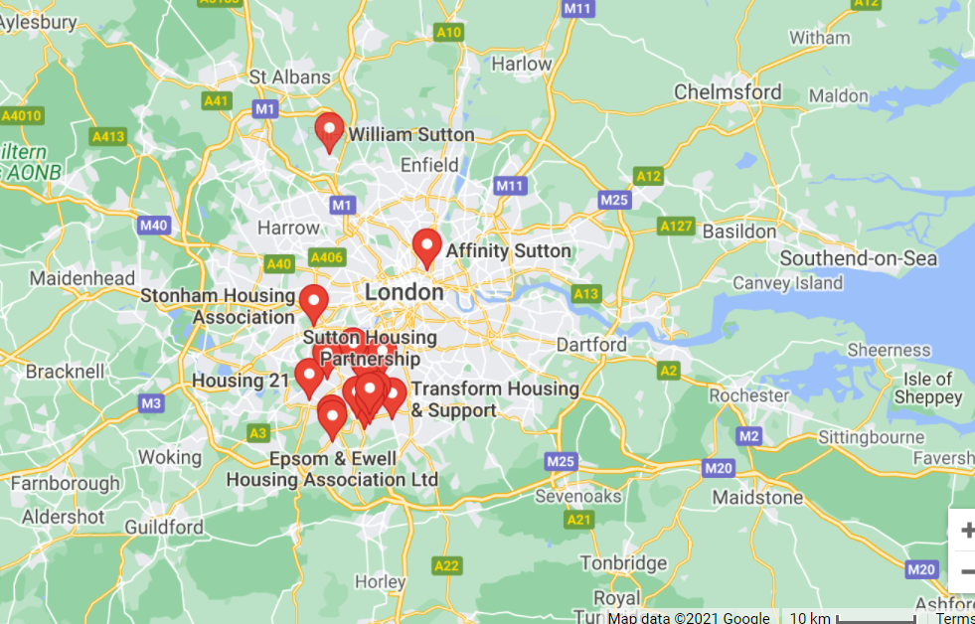
Housing associations in Sutton

Slide 19
Optivo and Housing & Care 21 are both housing associations that offer longer term housing solutions for people with learning disabilities, at Dymond House, and Travers Court.
For a more short term solution, or to learn independent living skills, Supported housing can be looked at as a solution.
Sutton Council provides support to people with learning disabilities living in their own homes. It has produced a booklet for people with learning disabilities, about the different types of housing you can live in. You can download the booklet by clicking these words. If you don’t understand something you can contact Sutton Council, using the details below. Sutton council learning disabilities team, Civic Offices, St Nicholas Way, Sutton SM1 1EA Telephone: 020 8770 6080 email: learningdisabilities@sutton.gov.uk Sutton council housing centre, Civic Offices, St Nicholas Way, Sutton SM1 1EA Telephone: 020 8770 6080 email: housing.centre@sutton.gov.uk You can also contact Mencap. Mencap is a charity that helps people with learning disabilities. Mencap learning disability helpline, 4 Swan Court Yard, Coventry Road, Birmingham, B26 1BU Telephone: 080 8808 1111 email: help@mencap.org.uk
What does Sutton Offer

Slide 20
Fiske Court - Anchor Hanover
No reviews · Housing association
35.3 mi · Sutton
Open 24 hours · 020 8661 9676
WEBSITE
DIRECTIONS
Sutton Housing Society Ltd
No reviews · Housing association
34.8 mi · Sutton
DIRECTIONS
Anchor - Deacon House
No reviews · Housing association
36.2 mi · Sutton
Open now · 0333 363 8851
WEBSITE
DIRECTIONS
Hanover Housing Association Ltd
No reviews · Housing association
36.7 mi · Worcester Park
0800 280 2575
WEBSITE
DIRECTIONS
Housing Associations in Sutton

Slide 21
Sutton Housing Partnership
2.6 (52) · Housing association
35.3 mi · Sutton
Open ⋅ Closes 5PM · 020 8915 2000
WEBSITE
DIRECTIONS
Sutton Housing Society
3.5 (11) · Housing association
35.7 mi
Open ⋅ Closes 5PM · 020 8642 1500
WEBSITE
DIRECTIONS
Hanover Housing Association Ltd
1.0 (1) · Housing association
35.3 mi · Sutton
020 8661 9676
WEBSITE
DIRECTIONS
Crown Housing Association Ltd
No reviews · Housing association
36.4 mi · Sutton
020 8642 2212
WEBSITE
DIRECTIONS
Housing Associations in Sutton

Slide 22
Sutton Federation of Tenant & Resident Association
No reviews · Association or organisation
35.3 mi · Sutton
020 8915 2349
DIRECTIONS
Epsom & Ewell Housing Association Ltd
5.0 (1) · Housing association
38.9 mi · Epsom
Open ⋅ Closes 5PM · 01372 748558
WEBSITE
DIRECTIONS
Transform Housing & Support
No reviews · Housing association
33.8 mi · Wallington
020 8773 1134
WEBSITE
DIRECTIONS
Hanover Housing Association
No reviews · Housing association
33.3 mi · Mitcham
Open now · 020 8646 6632
WEBSITE
Housing Associations in Sutton

Slide 23
Rosebery Housing Association Ltd
3.4 (16) · Housing association
38.8 mi · Epsom
Open ⋅ Closes 5PM · 01372 814000
WEBSITE
DIRECTIONS
Wilberforce Housing Association
5.0 (1) · Housing association
35.3 mi · London
020 8947 5233
DIRECTIONS
Camperdown House
2.5 (4) · Housing association
33.8 mi · Wallington
020 8773 1134
DIRECTIONS
Affinity Sutton
1.0 (1) · Housing association
28.1 mi · London
0300 100 0303
WEBSITE
DIRECTIONS
Housing Associations in Sutton

Slide 24
Housing 21
5.0 (1) · Housing association
39.4 mi · Surbiton
WEBSITE
DIRECTIONS
Haig Housing Trust
3.7 (16) · Housing association
34.9 mi · Morden
Open ⋅ Closes 5:30PM · 020 8685 5777
WEBSITE
DIRECTIONS
Abbeyfield House
No reviews · Assisted living residence
35.7 mi · Sutton
Open ⋅ Closes 5PM · 020 8394 0050
WEBSITE
DIRECTIONS
Abbeyfield House
No reviews · Assisted living residence
36.2 mi · Sutton
Open ⋅ Closes 5PM · 020 8394 0050
WEBSITE
DIRECTIONS
William Sutton
No reviews · Housing association
36.3 mi · Borehamwood
020 8235 7000
WEBSITE
DIRECTIONS
Housing Associations in Sutton

Slide 25
Right to apply & be treated fairly
Right to Information
If you have priority need or homeless, L.A has a duty to house (unless it is decided you made yourself homeless)
Equality Act 2010
Care Act 2014
Support to help young people find
Rights to Housing

Slide 26
Tammy Murray
Tammy.murray@residehousing.com
07913 614 924
Questions?????

Slide 27
Thank you !!

