Slide 1
Back to school after lockdown - Tips for Parents
You may have mixed feelings about the return to school once the COVID-19 lockdown is over, and you may be worried about how your child will cope. Here are some tips that we hope will be useful in helping you to support your child during this time of change.
Help your child manage their emotions by remaining calm yourself and teaching them calming down strategies: https://www.childline.org.uk/toolbox/calm-zone/ and https://www.mentallyhealthyschools.org.uk/media/2025/coronavirus-anxiety-toolkit.pdfhttps
Daily exercise, outdoor play and creative activities are all great to reduce stress – for younger children try soothing sensory play activities too
Balance out the worries and wobbles by encouraging positive thinking e.g. ‘what’s the best thing that happened today?’
1. Feeling anxious is normal Change is often stressful and while most children will cope fine, don’t be surprised if your child has a wobble at some stage.
2. We’re all in this together Help your child to rebuild their important relationships and social connections to smooth the transition and promote wellbeing.
3. Getting prepared for school Practical steps can be a useful way to get everyone back into the right mindset and feel ready for school.
4. A worry shared is a worry halved If your child has specific worries about school, you can help them manage these by giving them a chance to talk them through.
5. Missing family and home Some children may worry about missing their parents or other family members when they go back to school.
Talk about the people at school – ‘I wonder what Mrs Jenkins has been doing during lockdown?’ ‘Who are you looking forward to seeing at school?’
Reconnect with friends you have missed – send a text message or photo to say ‘hello I’m looking forward to seeing you at school’
Acts of kindness build positive connections, try: https://www.redcross.org.uk/ get-involved/teaching-resources/kindness-calendar
Get the morning routine back on track a few days before, awake and dressed on time!
Involve your child in sorting out their uniform and other things for school
Together create a visual timetable of the school day : check with school if the new timetable will be different from before, and talk about these changes with your child
Encourage independence by giving your child small tasks – can you pack your school bag?
Choose a quiet moment for ‘Worry time’ or ‘Question time’, allowing your child to share their concerns and ask for information. If worries pile up a ‘worry jar’ can be useful, write down your worries and choose a time to talk them through. Read more at: https://www.annafreud.org/media/11459/7waysanxiety.pdf:/
For many children simply knowing what to expect can reduce anxiety. A ‘social story’ written in a way your child can easily understand can be helpful for explaining and reassuring them about specific issues and concerns – see https://www.autism.org.uk/about/strategies/social-stories-comic-strips.aspx
Your child may need extra reassurance that everybody will be safe, “you’ll be ok at school, we’ll be ok here at home” – give them examples of what’s being done to keep us all safe.
Make sure your child is aware that home will be a boring place during the day and they won’t be missing out on fun time with you!
Together plan a treat for after school – a favourite snack, a family game or screen time?
Reassure your child that they will be held in mind even when they are away from you ‘I’ll be thinking of you’. A useful resource is ‘The Invisible String’ storybook by Patrice Karst.
Key questions about the return to school: your school is the best source of information about the re-opening. They will inform you of the dates, any changes to the normal set-up and the safety procedures in place.
No Limits on Learning
Educational Psychology Service

Slide 2
Back to school after lockdown - Tips for Parents
Mental health and wellbeing for children:
If you are worried about how your child is coping with the COVID-19 situation there are steps you can take to help them. Anxiety shows itself in different ways. Your child may appear anxious and talk about their worries, or there may be other signs, for example refusing to leave the house, being unusually withdrawn or unusually angry/emotional or having sleep difficulties.
Help them to recognise and talk about their feelings, especially around worries that the current situation may have provoked. Create a safe space for them to ask questions and consider how to answer in a way that is right for their age. It is important to address any ‘untruths’ they have heard. The following websites have useful resources for explaining coronavirus to children of different ages:
https://www.annafreud.org/media/11441/good-days-in-unusual-times-book.pdf
https://nosycrow.com/blog/released-today-free-information-book-explaining-coronavirus-children-illustrated-gruffalo-illustrator-axel-scheffler
https://www.unicef.org/coronavirus/how-talk-your-child-about- coronavirus-covid-19
https://carolgraysocialstories.com/wp-content/uploads/2020/03/Pandemics-and-the-Coronavirus.pdf
https://www.bbc.co.uk/iplayer (CBeebies Dr. Ranj explains Coronavirus on ‘Get well Soon’)
For ideas for maintaining wellbeing at this tricky time visit - https://youngminds.org.uk/blog/ supporting-your-family-s-wellbeing-during-isolation/#top-tips-for-coping-with-isolation
More general support and advice to help with behaviour, mental health and wellbeing can be found at https://www.bbc.co.uk/cbeebies/curations/parenthood-tips-and-tricks (good for parents of younger children, for example, ‘managing sibling rivalries’ and ‘keeping kids calm’)
If your child is really struggling, you should contact the SENCo at your school who can give you advice and may put you in touch with the school’s Educational Psychologist. If you feel you need more help, contact your family GP or contact these organisations for online advice telephone support: www.youngminds.org.uk, www.family-action.org.uk, www.familylives.org.uk
t
No Limits on Learning
Educational Psychology Service

Slide 3
Back to school after lockdown - Tips for Parents
Taking care of your own wellbeing:
The COVID-19 crisis has been a big challenge for families. Many families have increased money worries and job uncertainty, and many people will be worrying about their own health or those of family members. Being stuck together at home can be stressful and frustrating for adults and children alike. At the same time, our normal support networks of family, friends and school are not available meaning we can feel isolated and even overwhelmed.
In order to help your children feel safe and manage any of their anxieties, it is important that you also remember to take care of your own wellbeing. Feelings are contagious, you may have noticed how you pick up on positive or negative emotions of those around you; it is the same for children and young people. By taking steps to keep yourself well you can be a ‘super-spreader’ for positive mental health and support your children to look after themselves too.
Looking after yourself checklist:
Take time for yourself
Share the load
Find few minutes each day for exercise
Set a routine
Find time to switch off
Stay connected
Both of the following websites have useful advice for adults who are worried about their own mental health and wellbeing during COVID-19. This includes advice for promoting wellbeing and links to further support if needed:
https://youngminds.org.uk/blog/parents-tips-for-looking-after-yourself-in-lockdown/
https://www.nhs.uk/oneyou/every-mind-matters/coronavirus-covid-19-staying-at-home-tips/
If you need urgent help to support your mental health contact your GP or the following organisations: www.mind.org.uk, www.family-action.org.uk, www.familylives.org.uk
No Limits on Learning
Educational Psychology Service

Slide 4
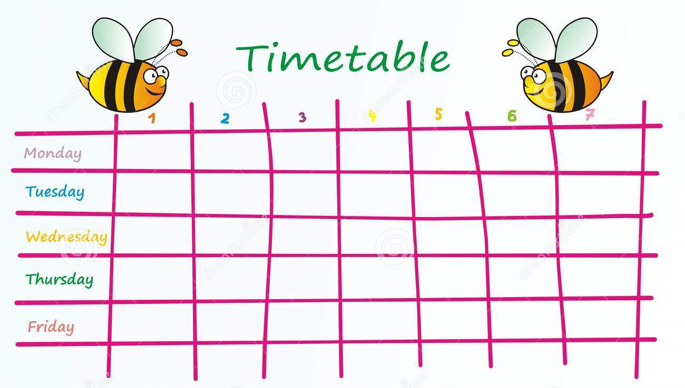
We’re looking forward to seeing you! ☺

Slide 5
