Slide 1
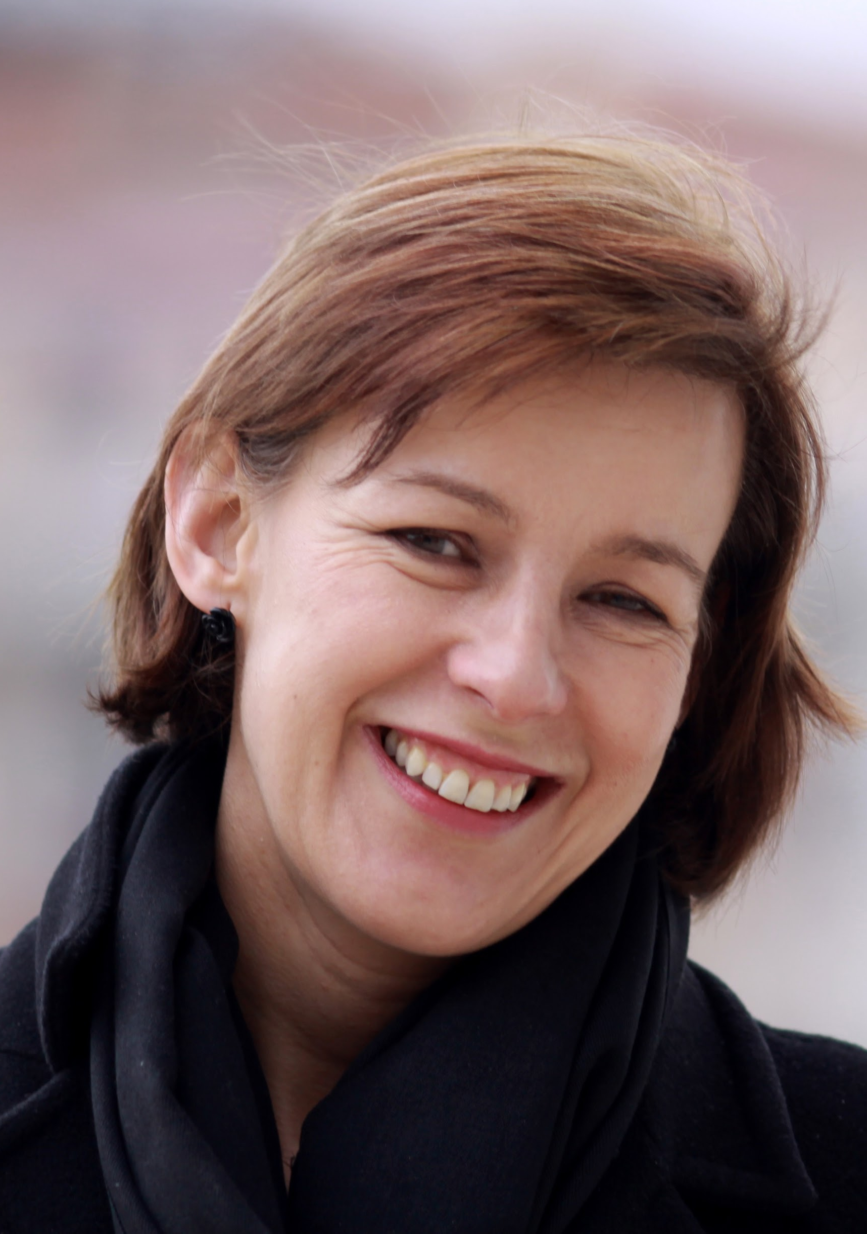
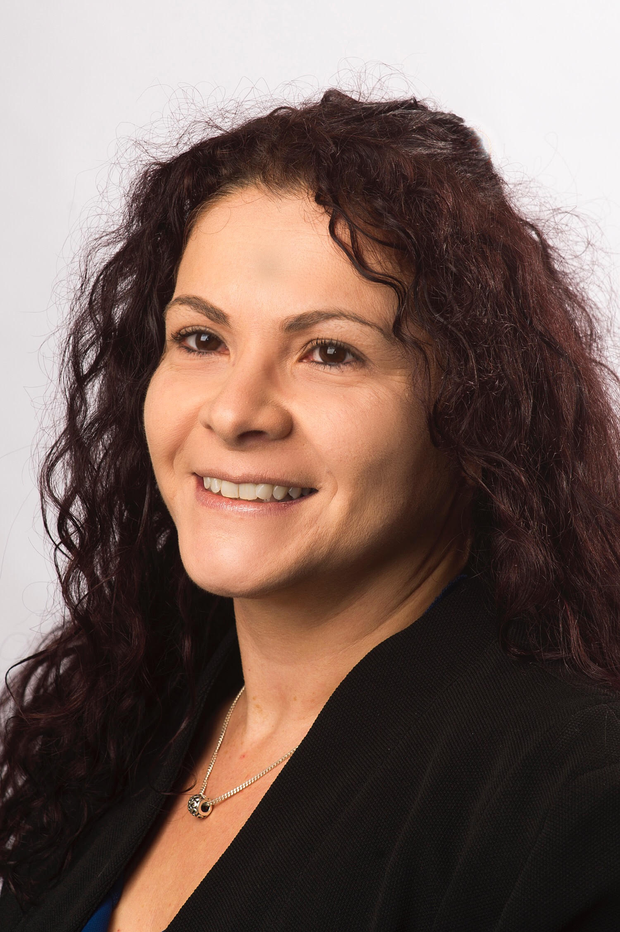
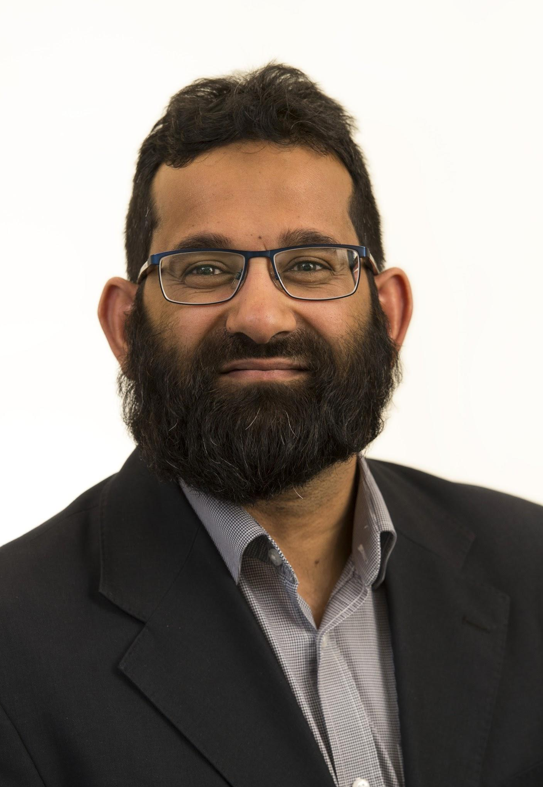
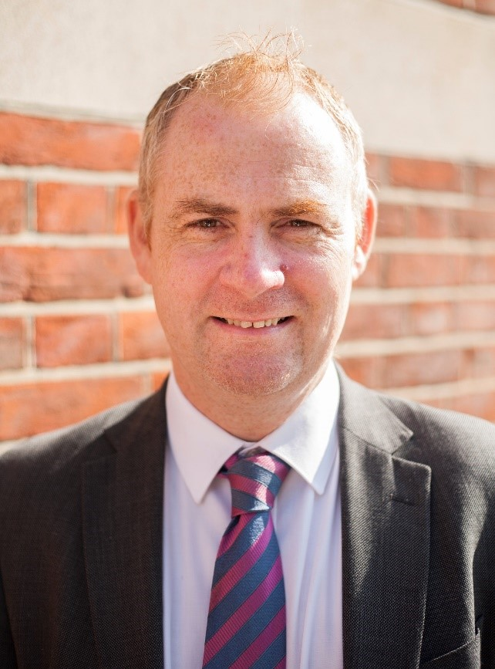
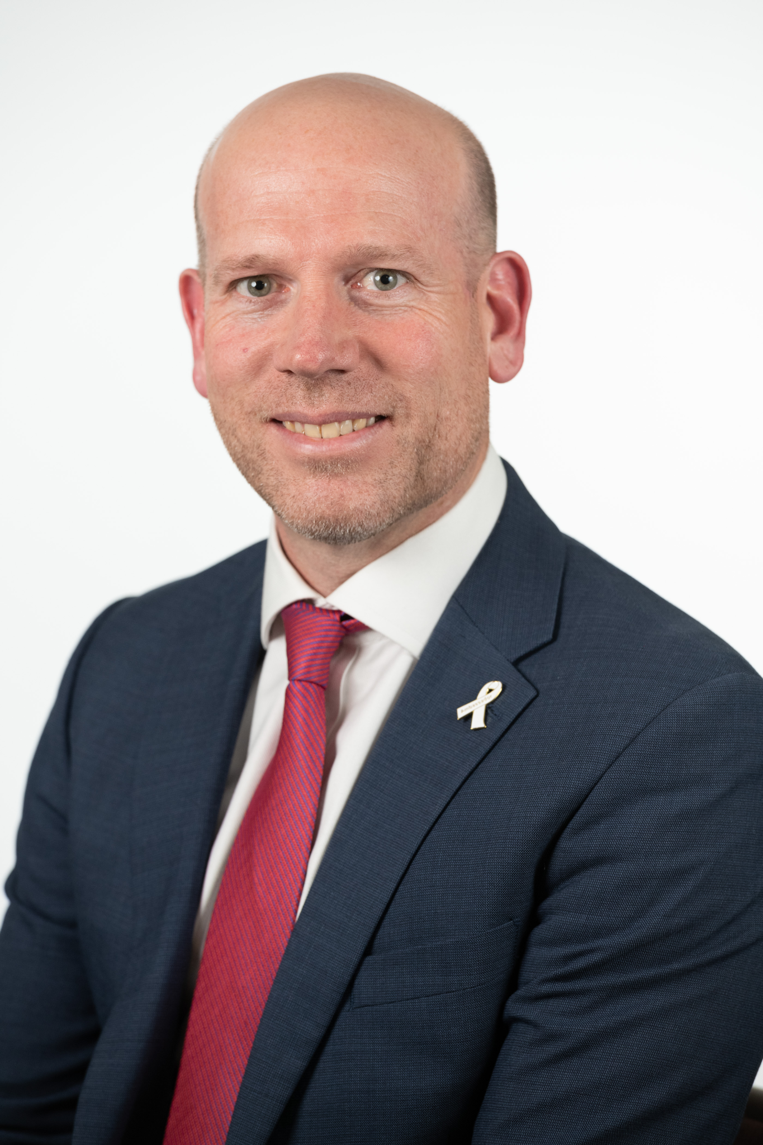

London Borough of Sutton – Structure Chart November 2025
Helen Bailey
Chief Executive
Responsible for implementing the decisions of the council ensuring all functions, duties and powers are properly exercised and overseeing the efficient planning of the council’s services. The Chief Executive is also the Electoral Registration and Returning Officer.
Martha Matheou
Head of Electoral
Services
Responsible for electoral registration, electoral administration and the delivery of all electoral functions.
Imran Choudhury
Strategic Director
of Public Health
and Wellbeing
Public Health
Substance misuse, sexual health and family planning, health visiting, school nursing and family nurse partnership and health lifestyles, Health protection, Quality Assurance
Health Service Commissioning
Libraries, Culture and Leisure, health and social care integration. Transport for older people, meals on wheels,
Sutton College, the Social Inclusion Centre and the Life Centre, Accountability for VCS
Richard Simpson
Strategic Director
of Resources
Finance (statutory CFO)
HR and OD
Digital and ICT
Asset Planning, Management and and Capital Delivery
Business Services
Customers, Transformation and Strategy
Law and Governance - Monitoring Office
Spencer Palmer
Strategic Director
of Environment,
Housing and
Neighbourhoods
Housing, Planning and Licensing
Highways, Transport and Regulatory Services
Building control
Environmental and Waste Management, Street Cleaning and Parking Services
Housing Advice Services
Sutton Housing Partnership, SDEN and Sutton Living Leadership of the Climate Emergency response
Nick Ireland
Strategic
Director of
People Services
Adults Social Care
Children's Social Care
Commssioning
Education and Target Family Support
Pupil based commissioning
Cognus
Accountability for Safeguarding
Assistant Director of Business Services
Ambitious for Sutton - Having the Right Capacity to Deliver

Slide 2

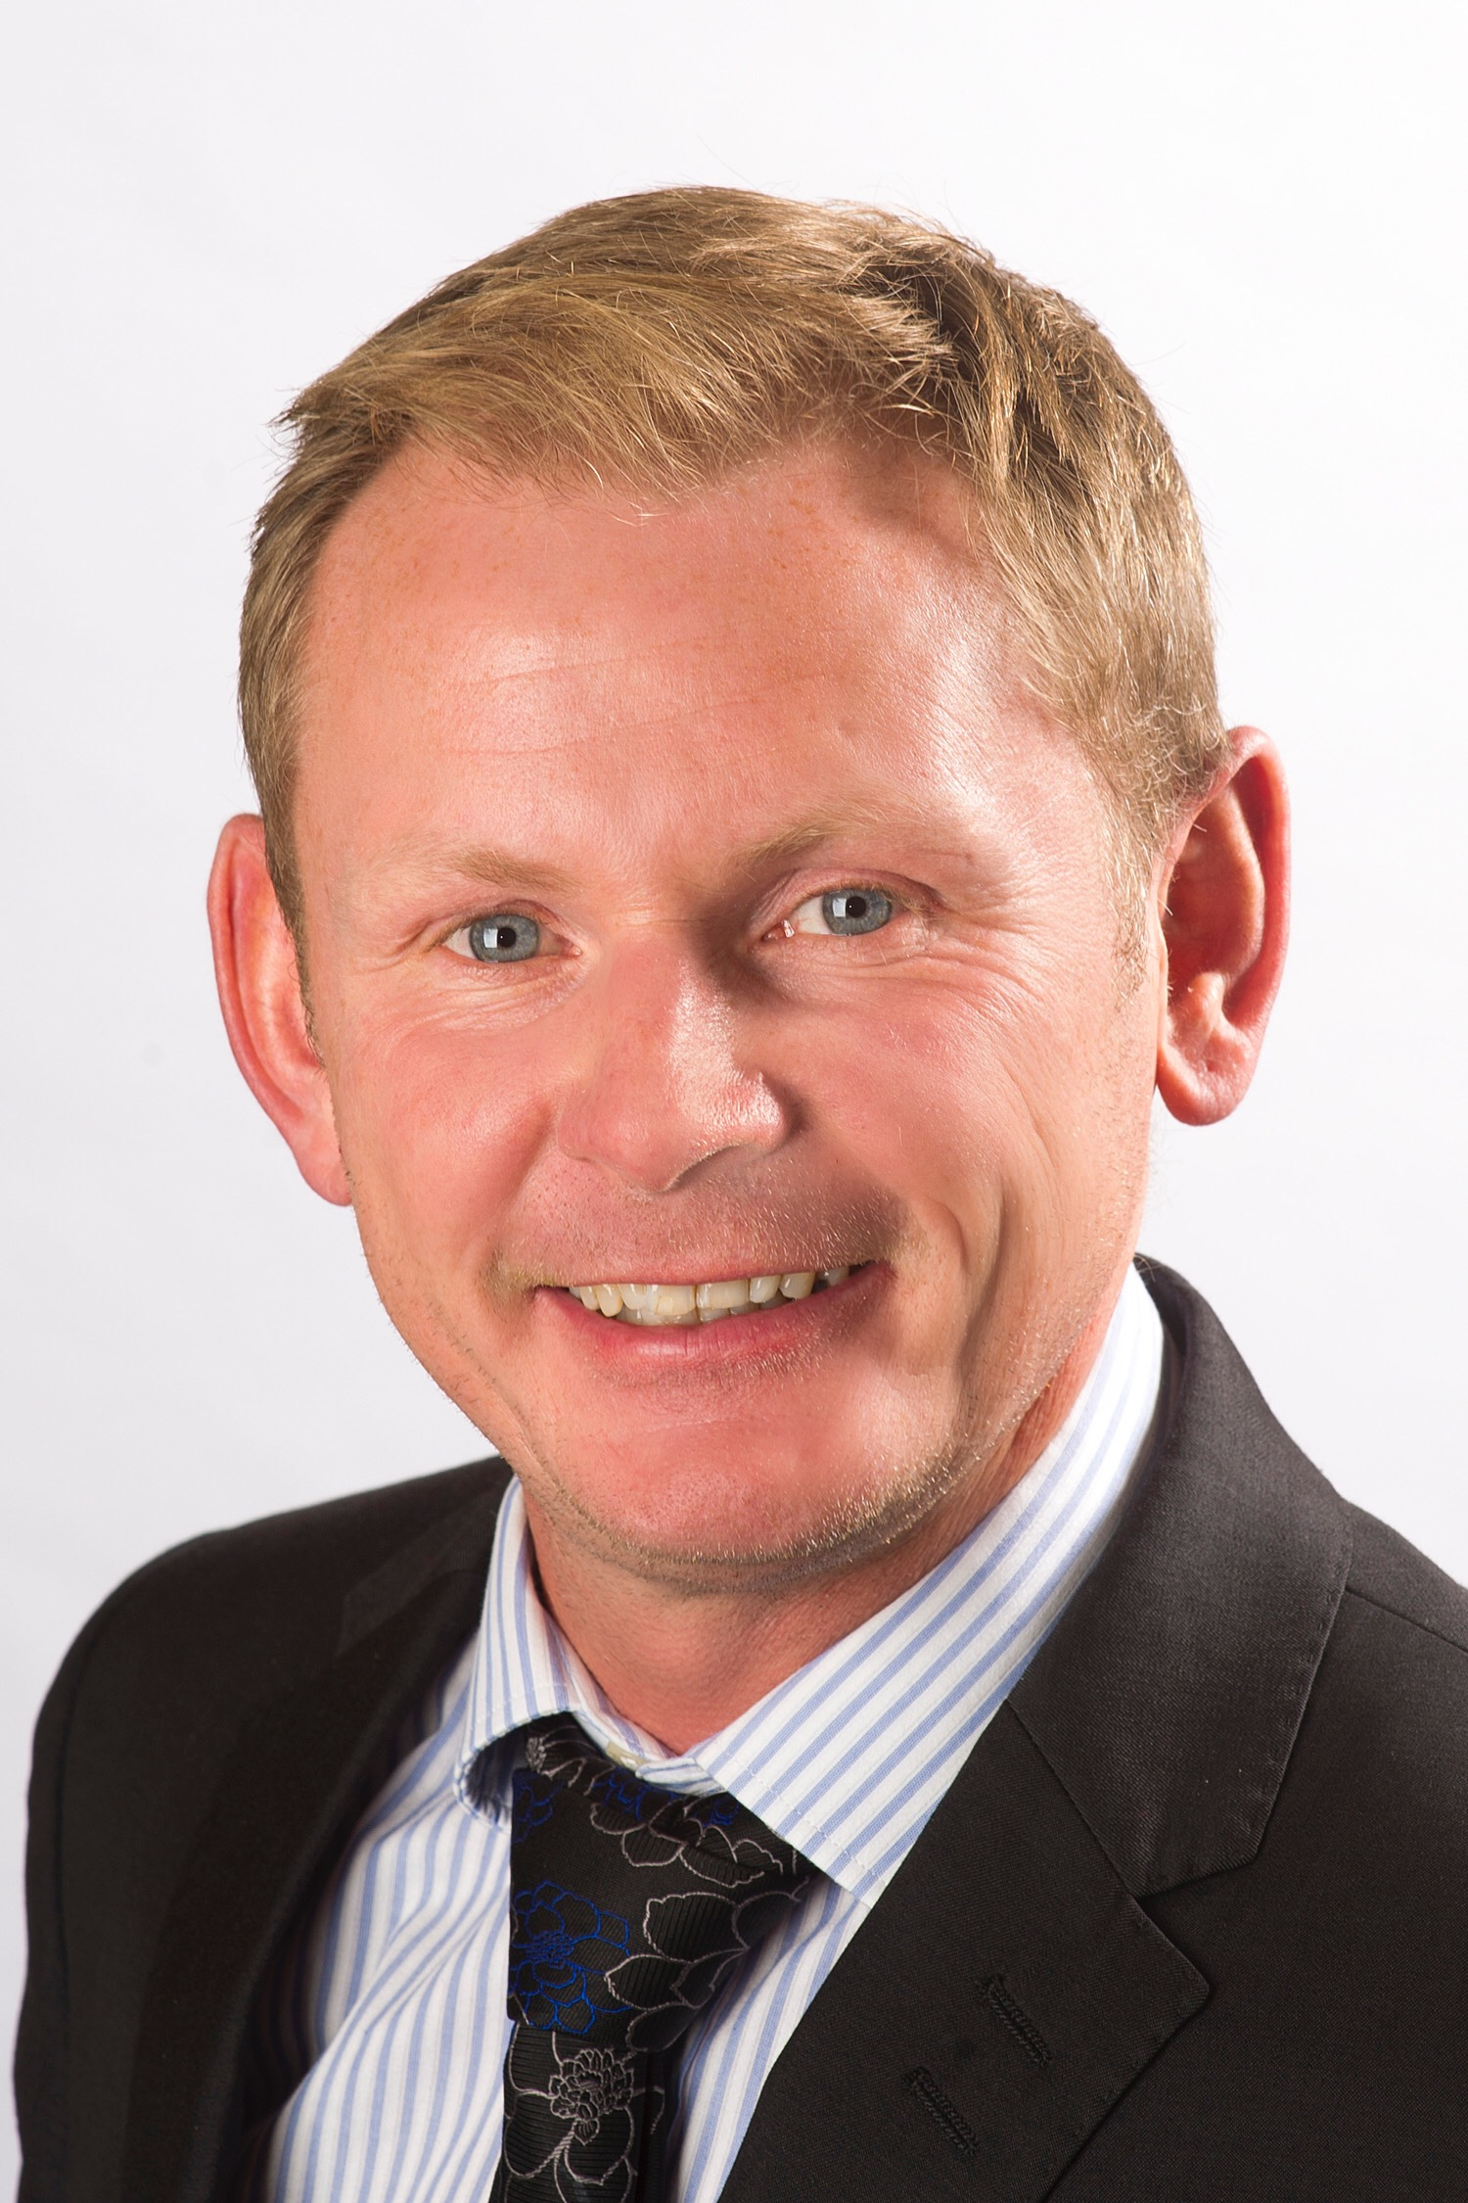
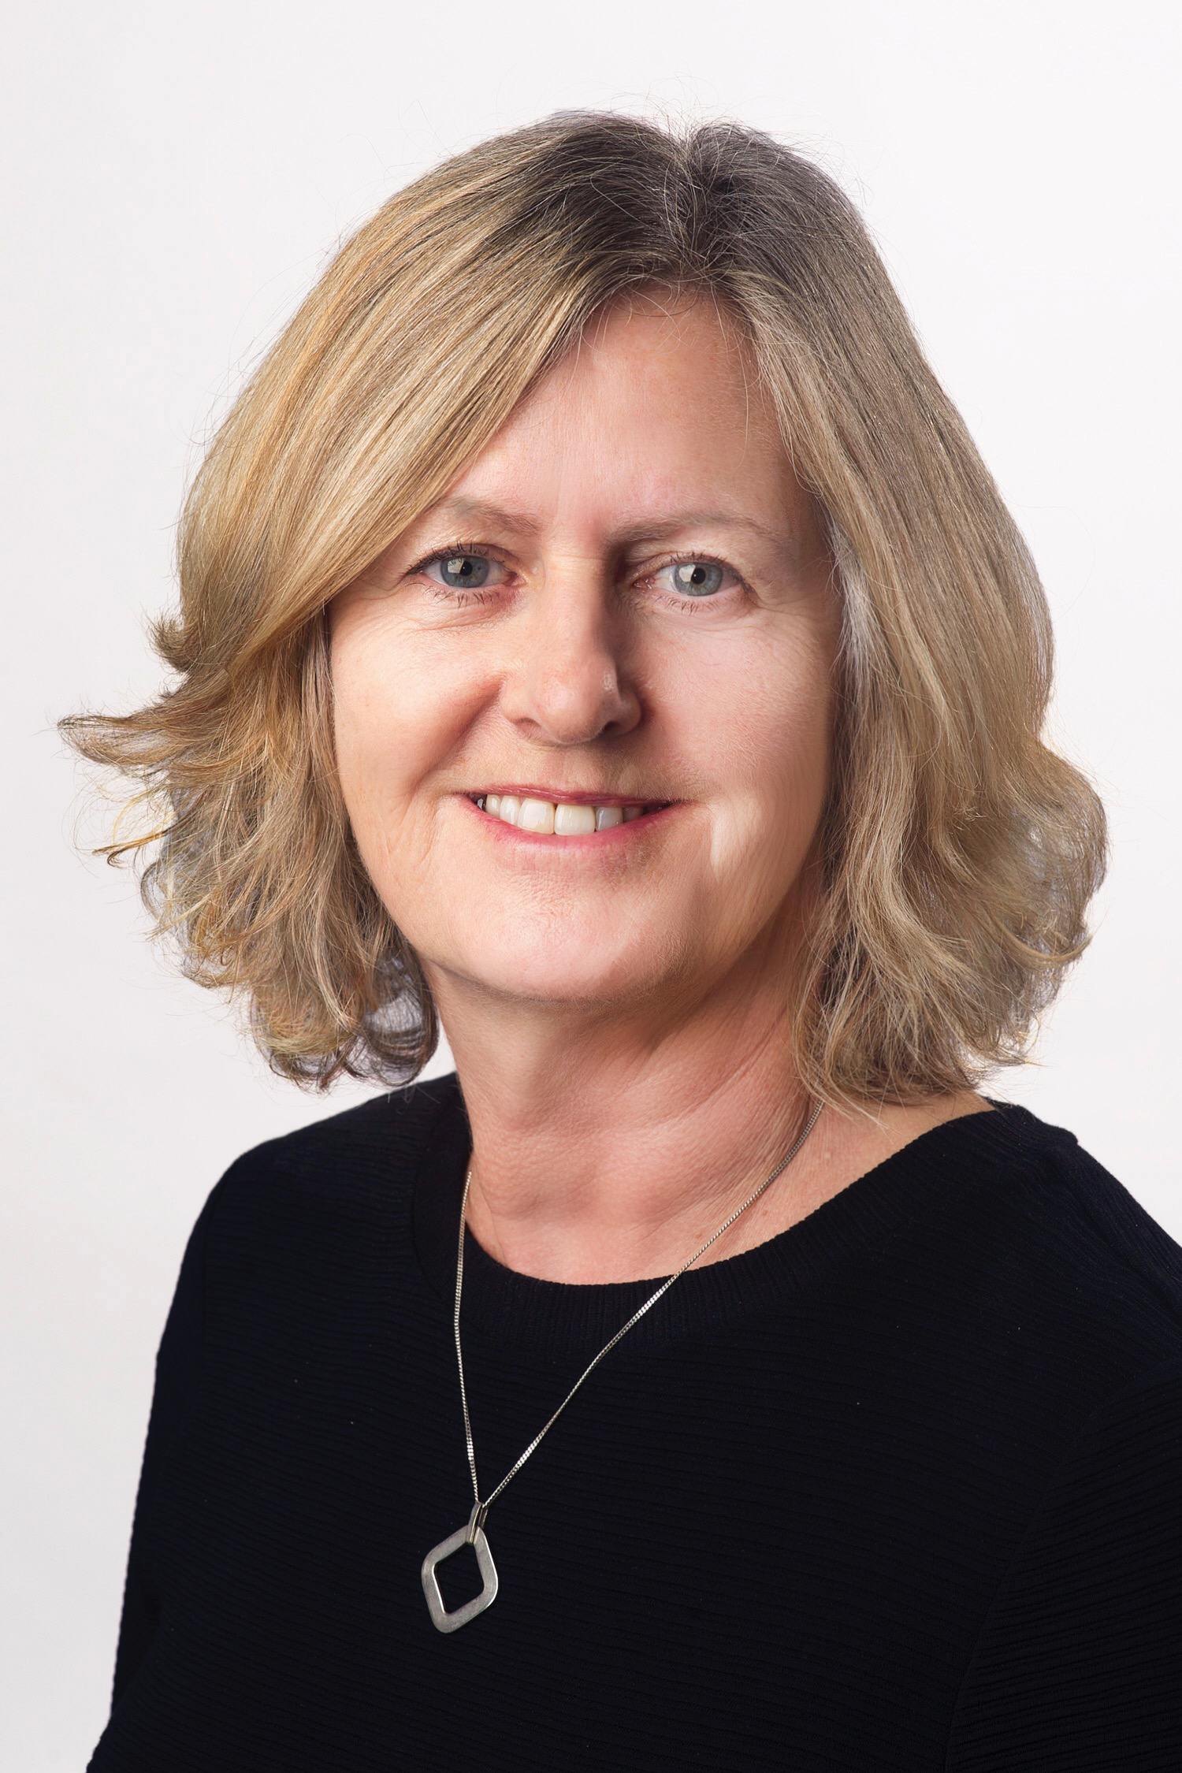
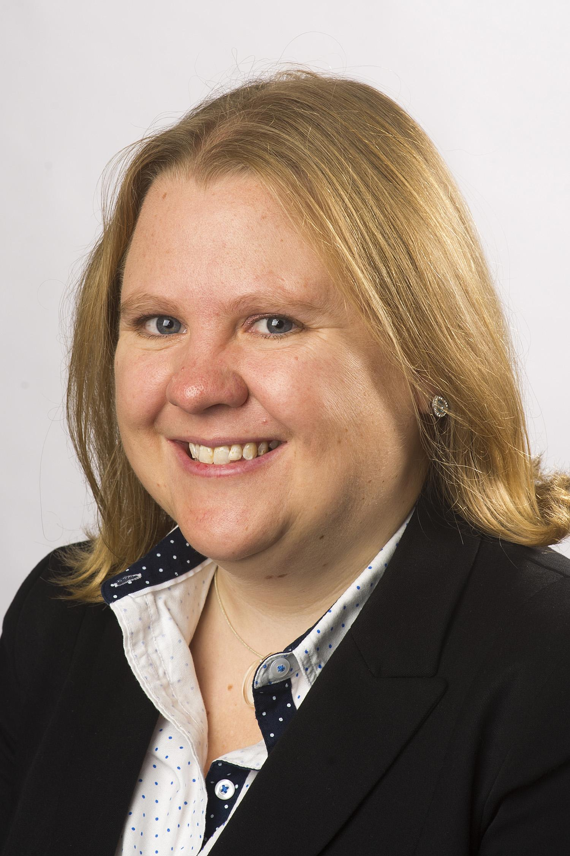
London Borough of Sutton – Organisational November2025 (1 of 2)
Helen Bailey
Chief Executive
Martha Matheou
Head of Electoral Services
Richard Simpson
Strategic Director of Resources
Imran Choudhury
Strategic Director of Public Health and Wellbeing
Nick Ireland
Strategic Director of People Services
(Statutory DASS)
Thuso Selelo
Director of Asset Planning, Management and Capital Delivery
Jonathan Williams
Director Children’s Services (Statutory DCS)
Janet Underhill
Director of Wellbeing
Jonathan Williams
Director Children's Services
Ben Unsworth
Director of Digital, Data & Technology
Jackie McCarthy
Interim Director Children’s Social Care and Safeguarding
Clare Ridsdill Smith
Head of Public Health Integration
Victoria Goddard
Director, Finance (Deputy S151 officer)
Kieran Holliday
Director Education, Integrated Support and Safer Communities
Beth Wilson
Head of Children's Health Services Sutton Health and Care
Sam Barker
Director of Customers, Transformation & Strategy
Lucy Botting
Director of Sutton Health and Care
Anna Saunders
Director Commissioning
Siraj Choudhury
Director Law & Governance (Monitoring Officer)
Sandra Howard
Director Adults Social Care
Emily Nice Director, HR & OD

Slide 3
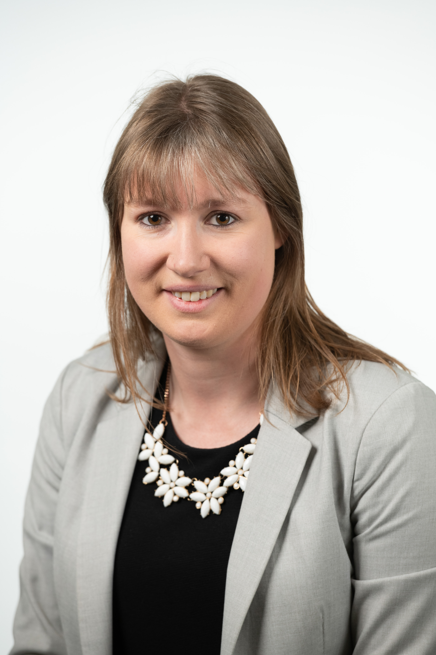
London Borough of Sutton – Organisational November 2025 (2 of 2)
Helen Bailey
Chief Executive
Spencer Palmer Strategic Director Environment, Housing and Neighbourhoods
Linmora Blair
Director of Housing
Sarah Rye
Director of Highways, Transport, and Regulatory Services
Jennifer Sibley
Director of Environment and Planning
Sarah Rye
Assistant Director of Highways, Transport, and Regulatory Services

Slide 4
Public Health and Wellbeing
Imran Choudhury
Strategic Director of Public Health and Wellbeing
Beth Wilson
Head of Children's Health Services Sutton Health and Care
Clare Ridsdill Smith
Head of Public Health Integration
Jan Underhill
Director of Wellbeing
Tom Dillon
Principal, Sutton College
Kelly Saini Badwal
Head of Cultural Services
Andrew Clark
Promoting Independence Programme Manager
Jean Bywaters
Registration Service Manager and Superintendent Registrar

Slide 5
ENVIRONMENT, HOUSING and NEIGHBOURHOODS
Spencer Palmer
Strategic Director Environment, Housing and Neighbourhoods
Linmora Blair
Assistant Director Housing
Firas Al-Sheikh
Managing Director Sutton Living Limited
Sarah Rye
Highways, Transport and Regulatory Services
Jennifer Sibley
Director, Environment and Planning
Adam Tucker
Head of Housing Enabling and Development
Steve Tucker
Managing Director Sutton Housing Partnership
Craig Adams
Head of Highways and Transport
Andrew Chandler
Head of Waste Contracts Transformation
Michael Hunte
Housing Regeneration Manager
Fiona Meads
Group Manager Enforcement Services
Victoria James
Head of Climate Action and Emergency Planning
Victor Igbins
Head of Housing Supply & Property Management
Mark Dalzell
Head of Parks and Open Spaces
(vacant)
Head of London Cancer Hub Capital Programme
Matthew Donaldson
Head of Parking and CCTV
Rachael Mounsey
Head of Finance Audit & Corporate Services
Jim Newton
Interim Head of Development Management and Strategic Planning
Marcus Rees-Harris
Head of Business Development
Paul Brockwell
Interim Head of Waste and Streets
David McIntyre
Managing Director SDEN

Slide 6
PEOPLE SERVICES DIRECTORATE
Nick Ireland
Strategic Director of People Services
(Statutory DASS)
Jonathan Williams
Director Children's Services (Statutory DCS)
Sandra Howard
Director, People Services (Adult Social Care)
Deborah Brough
Principal Social Worker
Jackie McCarthy
Interim Director Children’s Social Care and Safeguarding
Kieran Holliday
Director Education and Targeted Family Support
Lynne Brown
Head of Service: Hospital Pathway and Reablement
Anna Saunders
Director, Commissioning
Debbie Owen
Head of Service - Corporate Parenting
Amalia Banon
Head Of SEND
Abigail Olaleye
Head of Service - Adults First Contact Service, DoLS Safeguarding and General Duty
Katie Johnson
Head of Service, Commissioning
Jack Cutler
Head of Pupil Based
Commissioning
Andrea Green
Head of Service - Mental Health, Learning Disability and Transitions
Head of Service - Family Support and Care Planning
Justin Walker
Head of Service - Adult Social Care Support
Andrea Bryant
Head of Service - Children’s First Contact Service, EDT, Disability & Domestic Abuse Services
Angela Killalea
Head of Service - Integrated Support & Safer Communities
Peter Anike
Head of Service -Localities
Rosemary Elston-Smith
Principal Occupational Therapist
Occupational Therapy Hub
Michael Radley
Principal Social Worker and Practice Support & Development Service

Slide 7
RESOURCES DIRECTORATE
Richard Simpson
Strategic Director of Resources (S151 Officer)
Sam Barker
Director of Customers, Transformation and Strategy
Thuso Selelo
Director of Asset Management and Capital Delivery
Victoria Goddard
Director of Finance (Deputy S151 officer)
Emily Nice
Director of HR and OD
Ben Unsworth
Director of Digital, Data & Technology
Louise Fenner
Head of Communications and Engagement
Christopher Rhodes
Head Of Asset Management
Katherine Gray
Head of Pensions Investments and Treasury
Ayanna Bailey
Head of HR and OD
Jon Cheyne
Corporate Head of Digital Delivery
Jason Satchell
Head of Revenues and Benefits
Paul Algeo
Head Of Programme and Projects
Jez Simans
Head of Financial Reporting and Control
Dawn Matthews
Head of HR Shared and Traded Services
David Grasty
Corporate Head of Digital Transformation
Madeleine Neill
Head of Transformation and Customer Experience
Paula McCollin
Data and Systems Manager
Bradley Peyton
Head of Financial Planning and Business Partnering
Siraj Choudhury
Assistant Director Law & Governance (Monitoring Officer)
Tom Bates
Head of Digital Delivery
Fern Barber
Head of Policy, Insights and Communities
Lydia Stanley
Head of Facilities Management
John Smyth
Head of Finance Operations and
Residents Support
Alexa Coates
Head of Committee and Management Support
Rhian Allen
Information Governance and Records Manager & Data Protection Officer
Elizabeth Harris
Head of Inward Investment
Tom Taylor
Head of Pensions Administration

Slide 8
Helen Bailey - Chief Executive - helen.bailey@sutton.gov.uk
Imran Choudhury - Strategic Director of Public Health and Wellbeing - imran.choudhury@sutton.gov.uk
Jan Underhill - Director of Wellbeing - jan.underhill@sutton.gov.uk
Clare Ridsdill Smith - Head of Public Health Integration - clare.ridsdill-smith@sutton.gov.uk
Beth Wilson - Head of Children's Health Services Sutton Health and Care - beth.wilson@sutton.gov.uk
Lucy Botting - Director of Sutton Health and Care - l.botting@nhs.net
Richard Simpson - Strategic Director of Resources (S151 officer) - richard.simpson@sutton.gov.uk
Thuso Selelo - Director of Asset Planning, Management and Capital Delivery - thuso.selelo@sutton.gov.uk
Ben Unsworth - Director of Digital, Data & Technology - ben.unsworth@kingston.gov.uk
Victoria Goddard - Director of Finance (Deputy s151 officer) - victoria.goddard@sutton.gov.uk
Sam Barker - Director of Customers, Transformation and Strategy - sam.barker@sutton.gov.uk
Siraj Choudhury - Director Law & Governance (Monitoring Officer) siraj.choudhury@sutton.gov.uk
Emily Nice - Director of HR and OD - emily.nice@sutton.gov.uk
Spencer Palmer - Strategic Director of Environment, Housing and Regeneration - spencer.palmer@sutton.gov.uk
Sarah Rye - Director of Highways, Transport, and Regulatory Services - sarah.rye@kingston.gov.uk
Jennifer Sibley- Director, Environment and Planning jennifer.sibley@sutton.gov.uk
Linmora Blair - Director of Housing
Nick Ireland- Strategic Director of People Services (statutory DASS) - nick.ireland@sutton.gov.uk
Sandra Howard- Director Adult Social Care - sandra.howard@sutton.gov.uk
Anna Saunders - Director Commissioning
Jonathan Williams -Director Children's Services (Statutory DCS)- jonathan.williams@sutton.gov.uk
Jackie McCarthy - Interim Director Children’s Social Care and Safeguarding - jackie.mccarthy@sutton.gov.uk
Kieran Holliday - Director Education, Integrated Support and Safer Communities - kieran.holliday@sutton.gov.uk
Martha Matheou - Head of Electoral Services - martha.matheou@sutton.gov.uk

